Slide 1

Enhancing Customer Service Through LLM-Powered Email Drafting: An E.ON Data and Analytics Use Case
Aslıhan Berber, Mohammed Yazan Aljleilati
Data Analytics in Applications WS 25/26
January 30, 2026

Slide 2
Table of Contents
Introduction
Dataset Overview & Preparation
Topic Detection, Clustering & Labeling
Implementation & Modeling
Validation: Lexical Diversity & Semantic Variety Check
Hallucination Check
Streamlit Web App
Limitations & Future Outlook

Slide 3


Introduction
Context & Problem
High volume of customer emails at E.ON
Repetitive topics: billing, contracts, meter readings
Email handling is a major operational overhead (Thiergart et al., 2021)
Our Approach
End-to-end, human-in-the-loop drafting system (BCG, 2023; Costa & Ghosh, 2025)
Created synthetic response pairs to input data
Formal & friendly draft replies for agent support; used TinyLama; a compact open-source LLM under realistic constraints
Combined topic detection, summarization, and response generation
Generated formal & friendly draft replies for customer agents
Why LLMs
LLMs enable instruction-following & fluent text generation (Cai et al., 2025)
Proven effective as drafting assistants in customer service (Thiergart et al., 2021; Wulf & Meierhofer, 2023)
Successful real-world deployments in knowledge work (Ünlü, 2023)

Slide 4
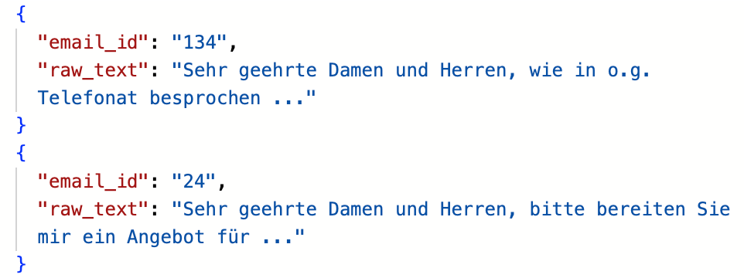
Dataset Overview & Data Preparation
Converted to JSON Lines
No heavy preprocessing
161 anonymized customer emails
Personal information was removed or replaced
Each Email-file contains one complete customer inquiry

Slide 5
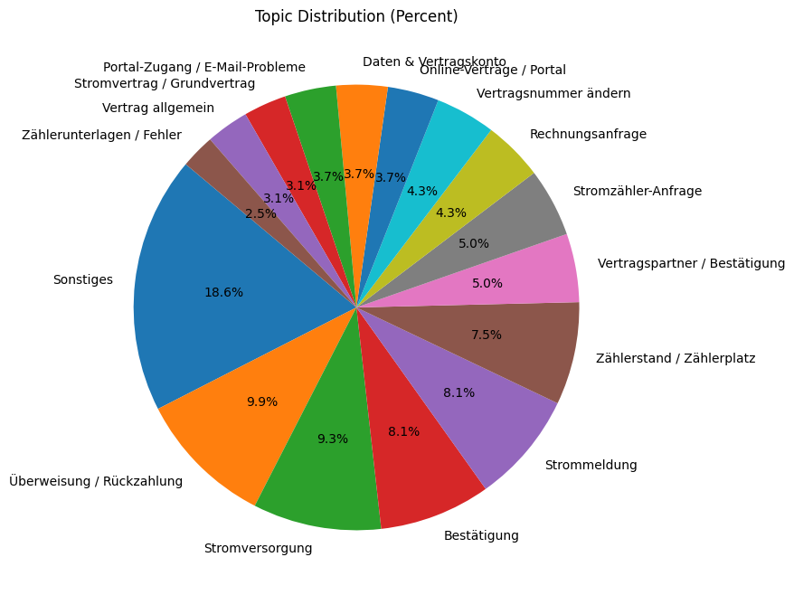
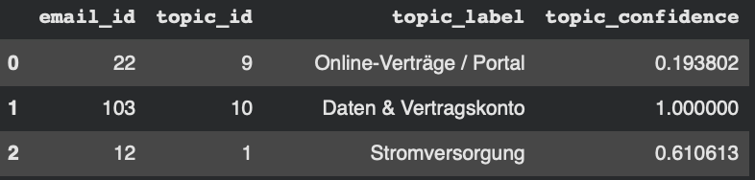
Topic Detection, Clustering & Labeling
BERTopic for semantic clustering
15 Clusters in total
Each email assigned to a topic
& confidence interval
Manual refinement of topic labels
Main topics: payments, electricity supply, meter readings, contracts

Slide 6

Implementation: Base LLM Model Choice
Why a Small Model & Design Motivation
Realistic compute constraints (Google Colab)
No access to large proprietary models
Exploratory focus on practical feasibility, not raw scale
Interest in compact models for enterprise use
Chosen Model
TinyLlama (1.1B parameters)
Chat-aligned, instruction-following
Built on a modern transformer architecture and has been pre-trained to follow natural-language instructions and generate assistant-responses
Open-source & lightweight
Libraries: PyTorch, Transformers, Peft, bitsandbytes, trl

Slide 7

Implementation: Fine Tuning Strategy (QLoRA)
Training Approach
Supervised instruction fine-tuning using a parameter-efficient optimization strategy
Synthetic instruction-response pairs
Two outputs per email: formal & friendly
Parameter-Efficient Optimization
LoRA adapters introduces a small number of trainable parameters into selected transformer layers while keeping the base model frozen
4-bit quantization
QLoRA for low-memory fine-tuning

Slide 8
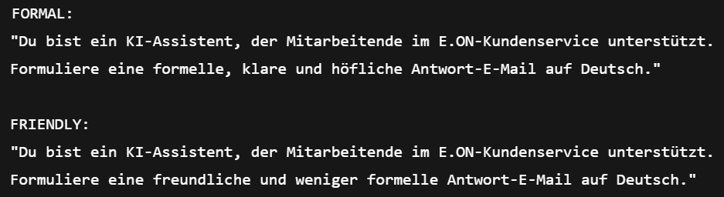
Implementation: Instruction Design & Tone Control
Explicit role definition: E.ON customer service assistant
Tone specified directly in the instruction
Same input → different stylistic targets

Slide 9
Implementation: Training Setup & Evaluation
Training Setup
80 / 20 train-validation split
600 update steps
Gradient accumulation for stability
Evaluation Metrics | Value
Total Samples | 322
Train/Validation split | 257/65
Training Steps | 600
Learning Rate | 2x10^-5
Effective Batch Size | 8
Training Loss | 1.48
Evaluation/Validation Loss | 1.30
A validation loss of ≈ 1.30 means:
The model assigns relatively high probability to the correct next tokens
The generated outputs are coherent and well-conditioned
The model is not guessing randomly
The model is not memorizing training data
Validation loss < training loss The model generalized instead of memorizing

Slide 10

Implementation: Inference and Safety Controls
Controlled Decoding
Deterministic decoding (beam search, 3 beams) -> so that the same email always produces the same output
Repetition control to avoid redundant phrasing
Reproducible and conservative outputs
Safety & Compliance Controls
Explicit instruction- and rule-based prompting
No hallucinated numbers, dates, or contact details
Ask follow-up questions if information is missing
Human-in-the-loop review remains mandatory
Inference Pipeline
Topic assignment using BERTopic
Rule-based short summary generation
Dual-tone response drafting (formal & friendly)

Slide 11
Implementation: Inference and Safety Controls
No Fact Invention
If the customer email does not contain a contract number or amount, the model is explicitly instructed not to invent one.
Exact Reuse of Numbers
If the customer writes “103,22 €”, the model must reuse “103,22 €” exactly and is prohibited from rounding or modifying it.
No Assumed Actions
The model is forbidden from stating that a payment was completed unless the customer explicitly confirms it in the email.
Missing Information Handling
When required details are missing, the model must ask 2-4 concrete follow-up questions instead of guessing.
No Invented Dates or Timelines
Dates such as “am 22.02.2022” or “seit 2019” may only appear if they occur verbatim in the customer email.
Deterministic Output
The same customer email always produces the same response due to deterministic decoding without sampling.
Signature Enforcement
If the model repeats or omits the closing, the system removes duplicates and enforces a single E.ON signature.

Slide 12

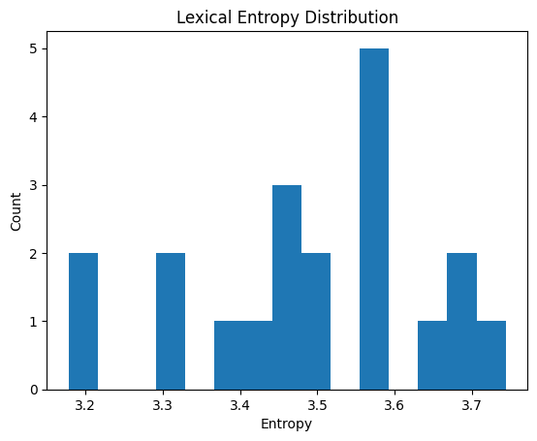
Validation: Lexical Diversity Check
Objective: Detect whether the model collapses into repetitive, template-like phrasing
Method:
Lexical entropy over generated responses Measures vocabulary diversity Penalizes repeated or formulaic wording
Input data (unseen emails, n=10): All generated outputs (formal + friendly combined) Text normalized (lowercasing, whitespace cleanup)
Implementation details:
Tokenize responses into word tokens
Compute token frequency distribution
Calculate entropy
Results:
Mean entropy = 3.49 -> good diversity for emailing
Standard deviation = 0.15 -> stable behavior
No low-entropy collapse observed
Responses showed controlled linguistic variation, not copy-paste templates

Slide 13
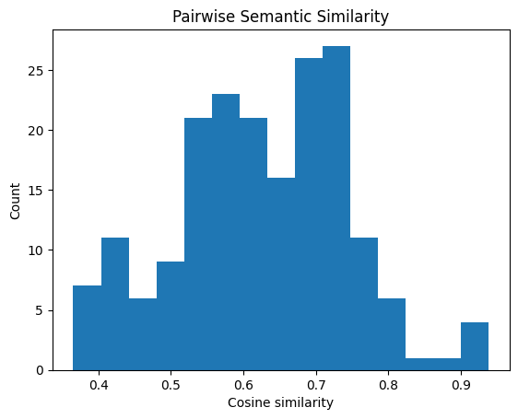
Validation: Semantic Variety Check
Objective: Ensure responses vary in phrasing without drifting in meaning
Problem addressed: Lexical variation alone can hide semantic inconsistency
Embedding model used:
all-MiniLM-L6-v2 (Sentence-Transformers)
Lightweight, fast, suitable for short texts
Implementation details:
Encode each generated response into sentence embeddings
Compute pairwise cosine similarity
Exclude self-similarity (diagonal removed)
Results:
Mean cosine similarity = 0.62
Standard deviation = 0.11
Majority of pairs fall in mid-to-high similarity range
Responses remain semantically aligned
Still, allows phrasing and structural variation

Slide 14

Hallucination Check: Factual Grounding Validation
Why hallucination check matters
Incorrect facts can cause billing errors, legal risk, and GDPR violations
Especially critical in regulated domains like energy
What we validate
New facts introduced by the model vs. customer email
Checked entity types:
Numbers (amounts, contract IDs)
Dates
Email addresses
URLs
Phone numbers
How it works
Rule-based extraction using regex
Normalization to handle formatting differences (e.g., “232 671” → “232671”)
Per-response hallucination flagging/risk detection
(Set difference: response facts − input facts) =
Any new entity ⇒ hallucination flag
Final results (unseen emails, n = 10)
Formal responses: 0% hallucination
Friendly responses: 0% hallucination
No new factual entities introduced
Model reliably grounds responses in customer input
Suitable for internal drafting with human review

Slide 15
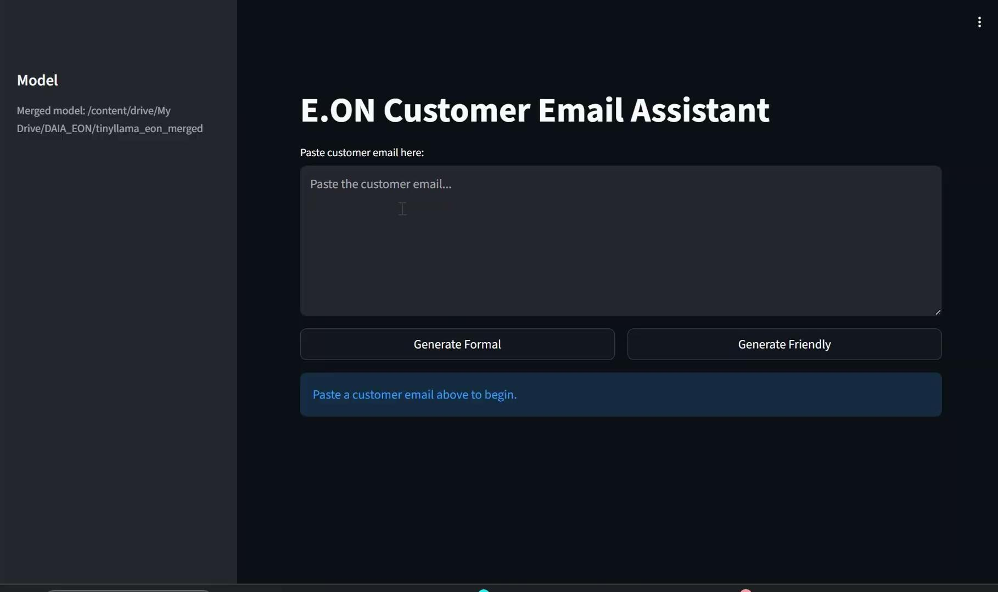
Streamlit WebApp

Slide 16

Limitations & Future Outlook
Key Limitations
Compact TinyLlama model (performance ceiling)
Synthetic training data (no real agent replies)
No human-in-the-loop user study
Limited evaluation sample size
Limited data size for training
No backend or RAG integration
Future Outlook
Testing larger models under same constraints
Testing with more data
Incorporating agent feedback / edits
Running human-in-the-loop evaluations
Integrating retrieval-augmented generation to provide accurate and factually grounded answers
Including a more personalized tool and user interface

Slide 17
References
Boston Consulting Group. (2023, July 6). How generative AI is already transforming customer service.
Cai, W., Jiang, J., Wang, F., Tang, J., Kim, S., \& Huang, J. (2025). A survey on mixture of experts in large language models. IEEE Transactions on Knowledge and Data Engineering, 37(7), 3896–3915. https://doi.org/10.1109/TKDE.2025.3554028
Costa, C., \& Ghosh, S. (2025). Empowering customer service with generative AI: Enhancing agent performance while navigating challenges.Information Research, 30(iConf). https://doi.org/10.47989/ir30iConf47566
Janssens, W., Bogaert, M., \& Van den Poel, D. (2025). LLM-assisted topic reduction for BERTopic on social media data (Version 1). arXiv.lhttps://doi.org/10.48550/arXiv.2509.19365
Thiergart, J., Huber, S., \& Übellacker, T. (2021). Understanding emails and drafting responses: An approach using GPT-3 (Version 3).arXiv. https://doi.org/10.48550/arXiv.2102.03062
Ünlü, C. (2023). InterpreTutor: Using large language models for interpreter assessment. In \textit{Proceedings of the International Conference on Human-Informed Translation and Interpreting Technology (HiT-IT 2023)}, Naples, Italy. https://doi.org/10.26615/issn.2683-0078.2023_007
Wulf, J., \& Meierhofer, J. (2024). Utilizing large language models for automating technical customer support (Version 1).arXiv.https://doi.org/10.48550/arXiv.2406.01407

Slide 18
Thank You!
Munich, 30. January 2026

